Slide 1
A New Approach to Vowel Visualization
Presenter
Harold H. Hendricks
Brigham Young University
Provo, Utah, USA

Slide 2
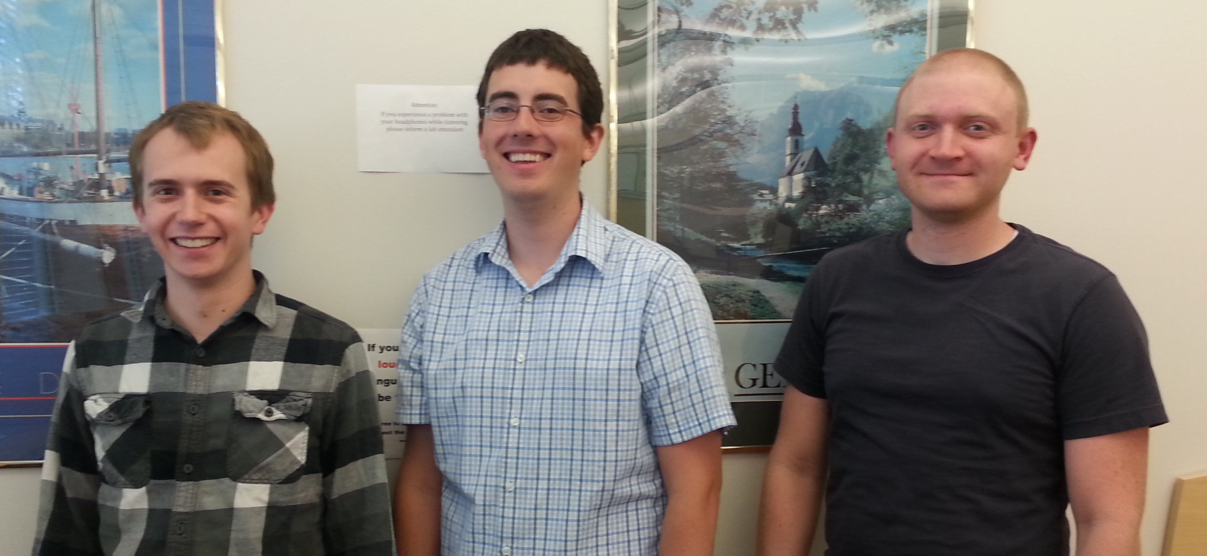
Credit Where Credit is Due
Ian Hunter
Undergraduate
Programmer
Derrick Craven
Undergraduate
Programmer
Cory Robinson
Graduate
Linguist

Slide 3
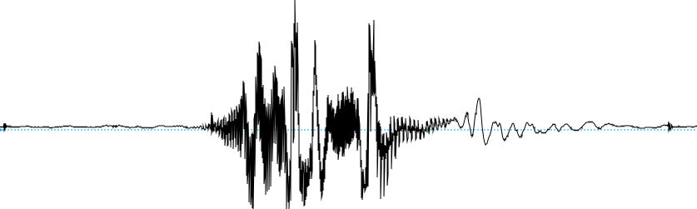
The Impetus
How to provide students with a better method of understanding and visualizing pronunciation than by the standard waveform interface?

Slide 4
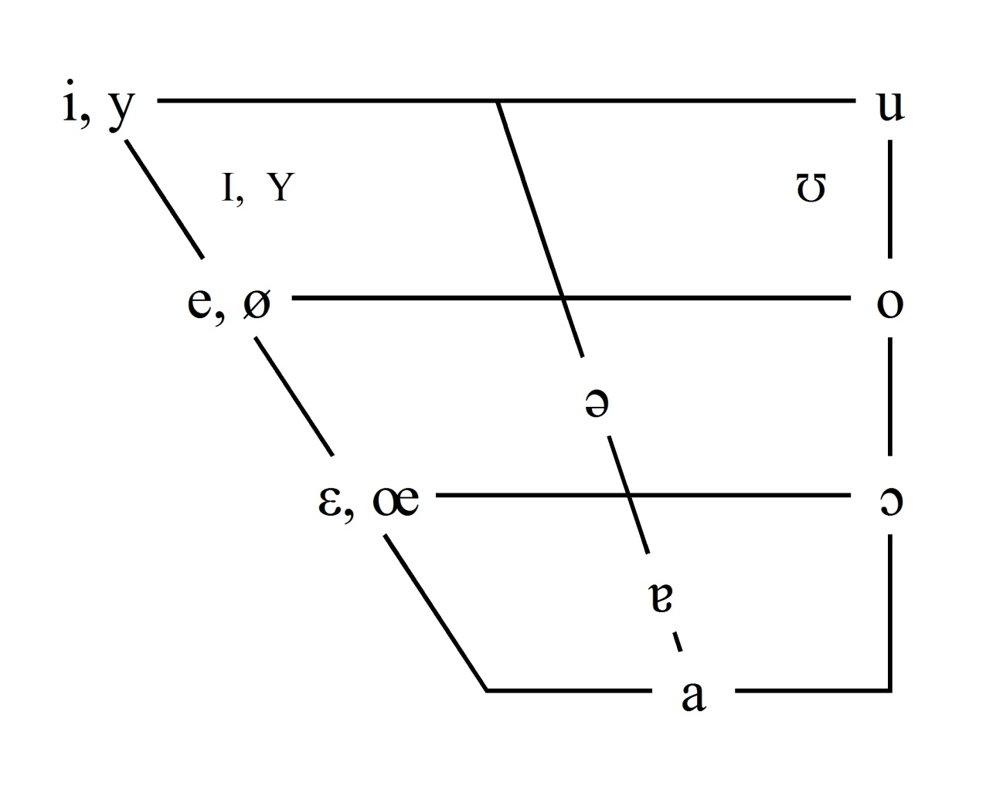
Point of Departure
The vowel space chart with target ovals.
German 101 as the test case.

Slide 5
Pilot Version: APE
Automatic Pronunciation Evaluator
Students record prompted words from a list.
Pilot study conducted in 2013 with 2nd-semester German students
http://ape.byu.edu

Slide 6
The Basics
Vowels are distinguished by:
The position of the tongue
The position of the lips
The length of time pronounced

Slide 7
Tongue Position
The position of the tongue is based on it’s highest point.
This point is measured by height and advancement.

Slide 8
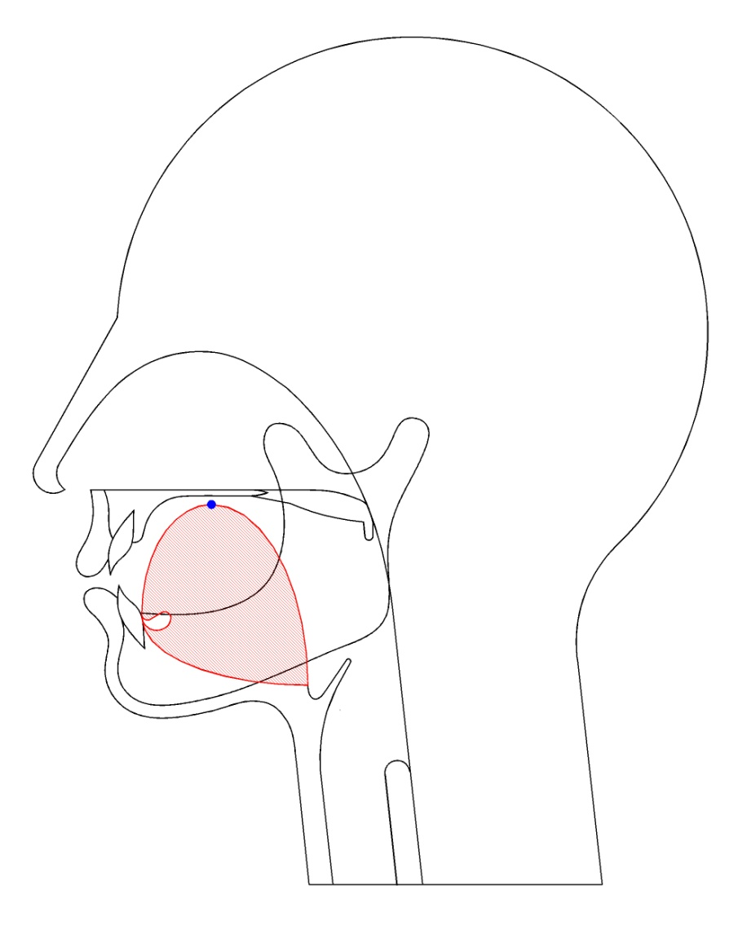
Tongue Position
For example, it moves from e as in see…

Slide 9
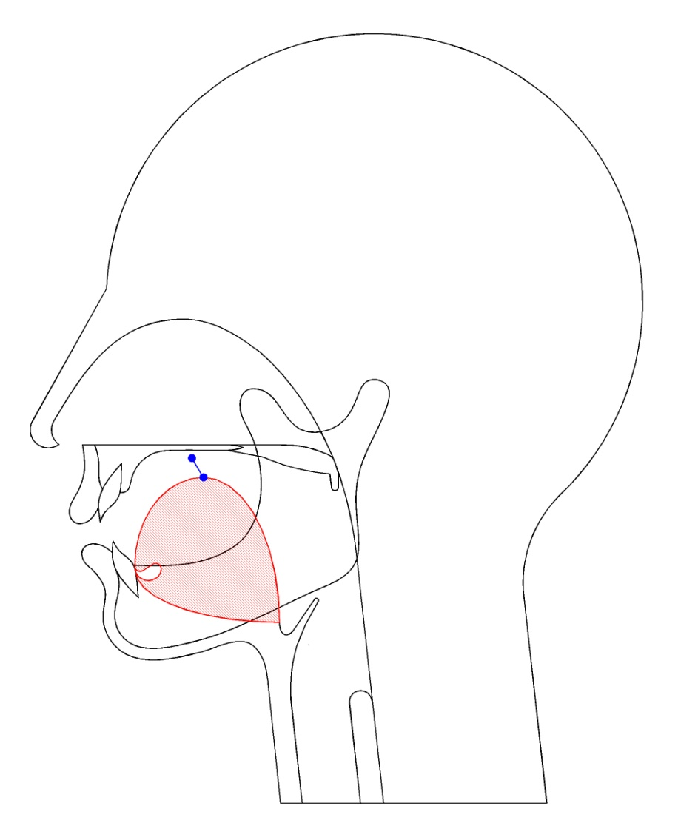
Tongue Position
to a as in say…

Slide 10
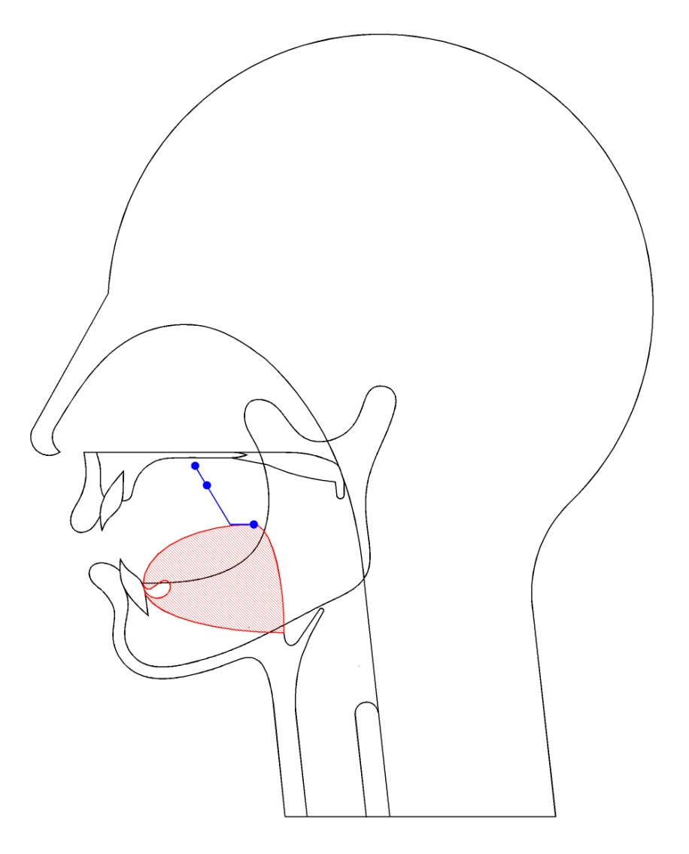
Tongue Position
to ah as in saw…

Slide 11
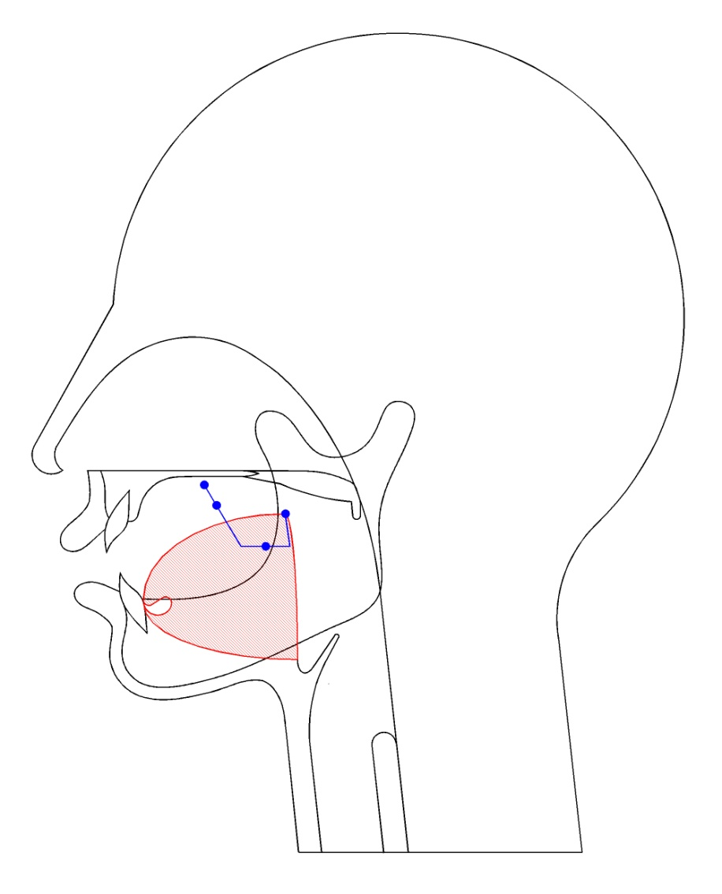
Tongue Position
to o as in so…

Slide 12

Tongue Position
to u as in sue…

Slide 13
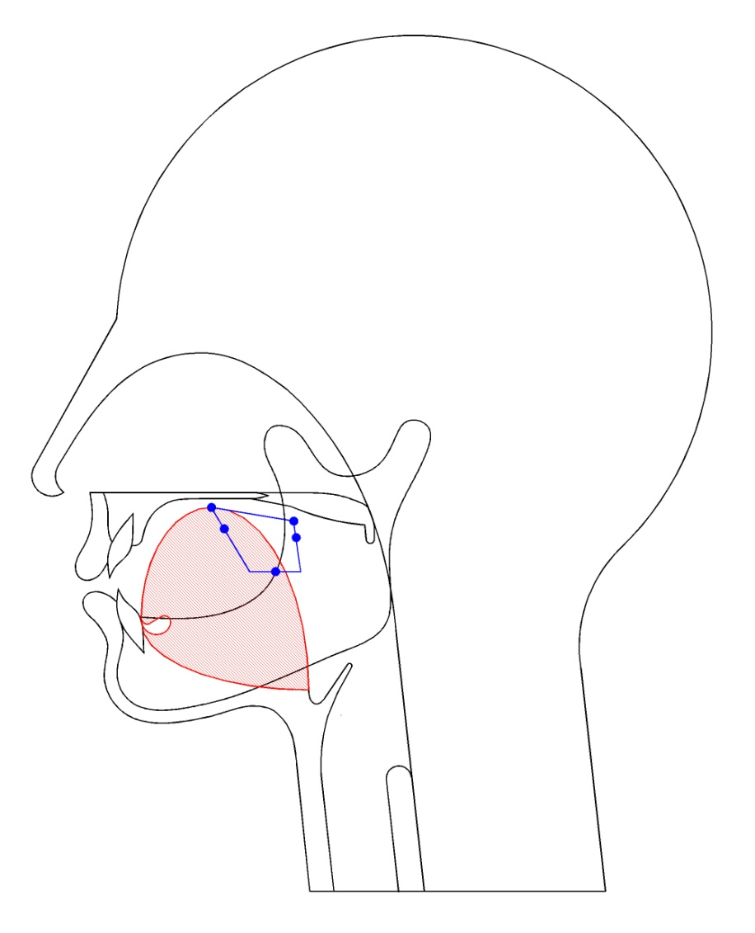
Tongue Position
and back to e.

Slide 14
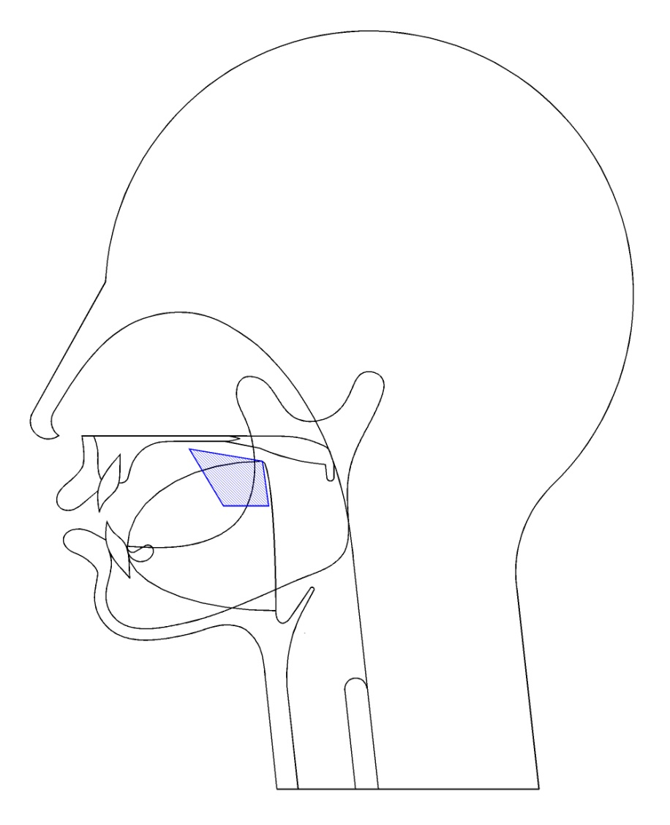
Tongue Position
This area is called the vowel space.

Slide 15
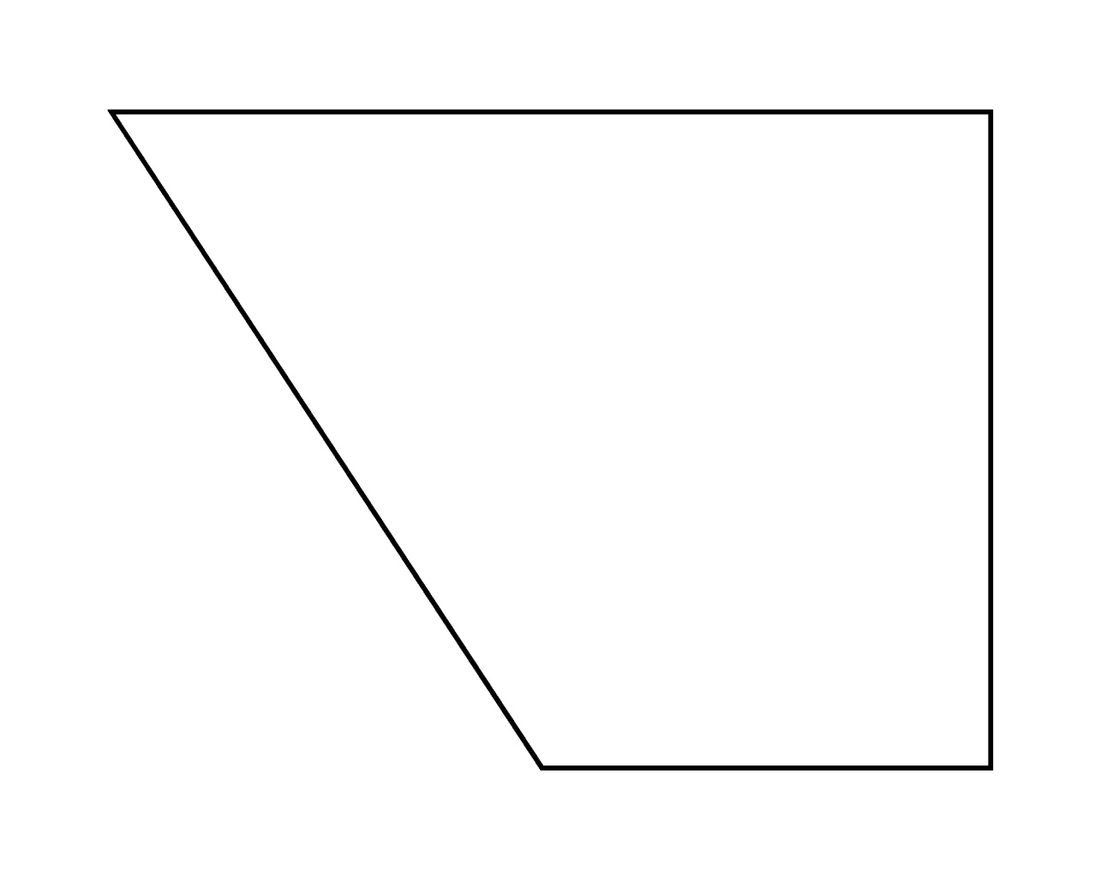
Tongue Position
It is the same area represented by this chart.

Slide 16
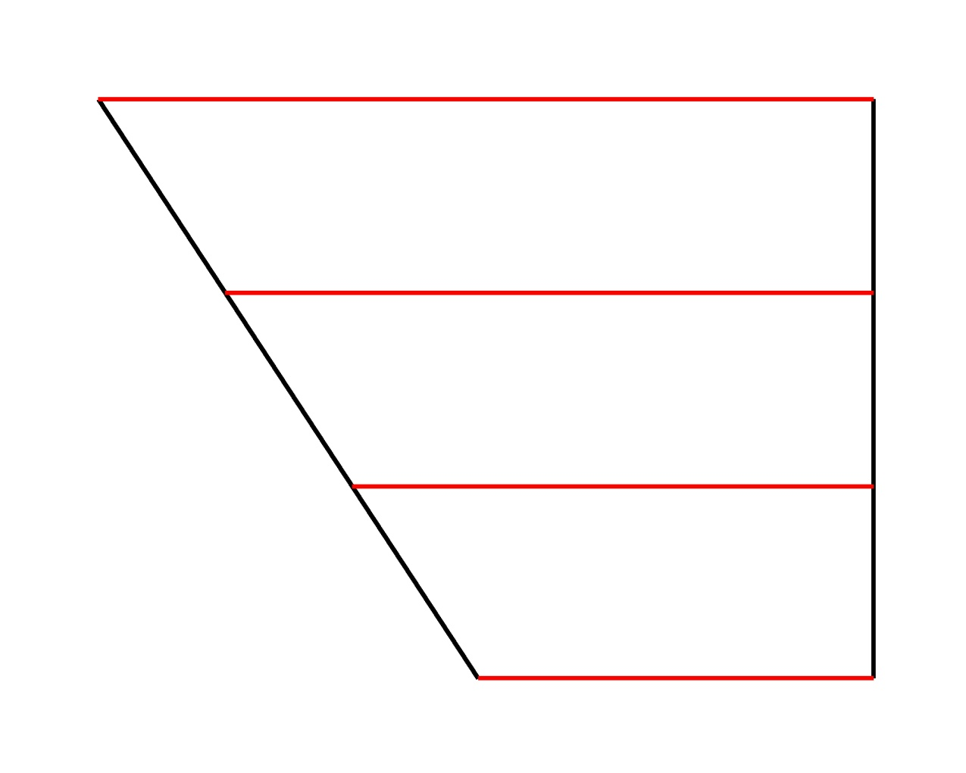
Tongue Position
Height may be high, mid-high, mid-low, or low.

Slide 17
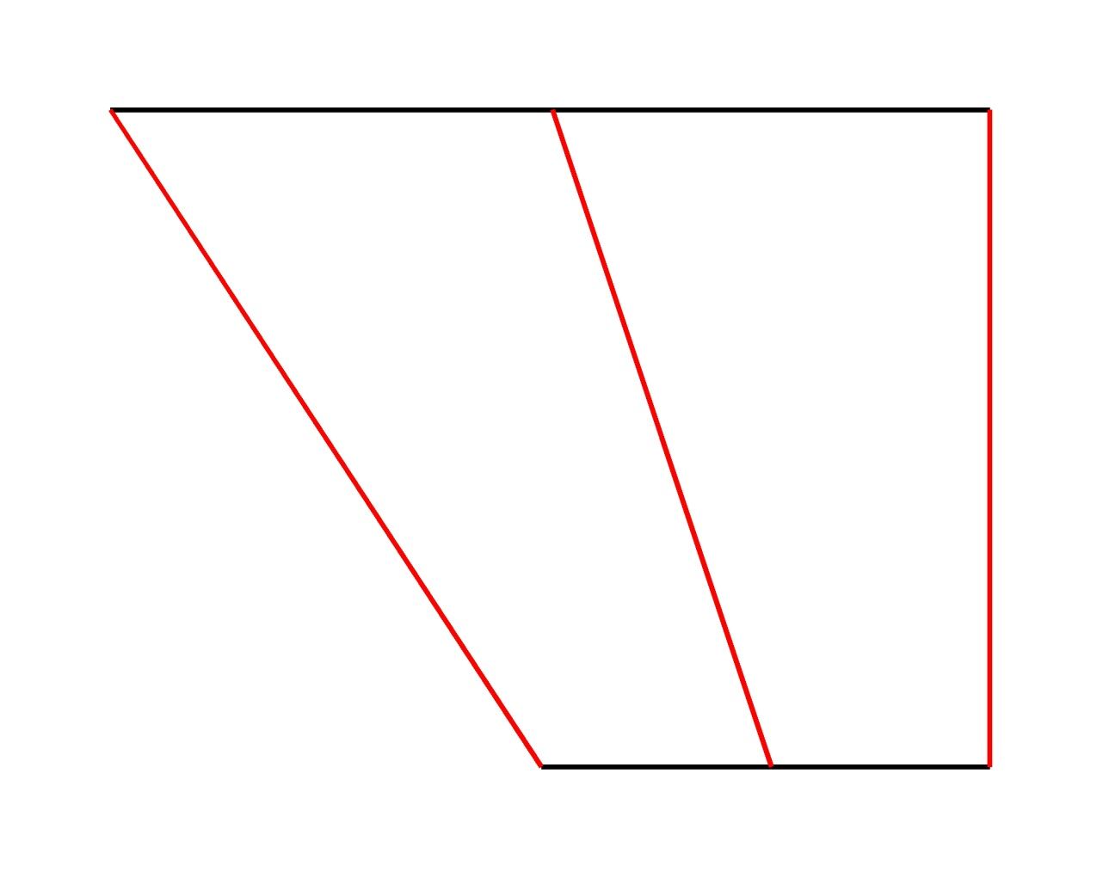
Tongue Position
Advancement may be front, central, or back.

Slide 18
Tongue Position
Phonetic symbols appear by tongue position.

Slide 19
Tongue Position
However, tongue position isn’t so restricted.

Slide 20
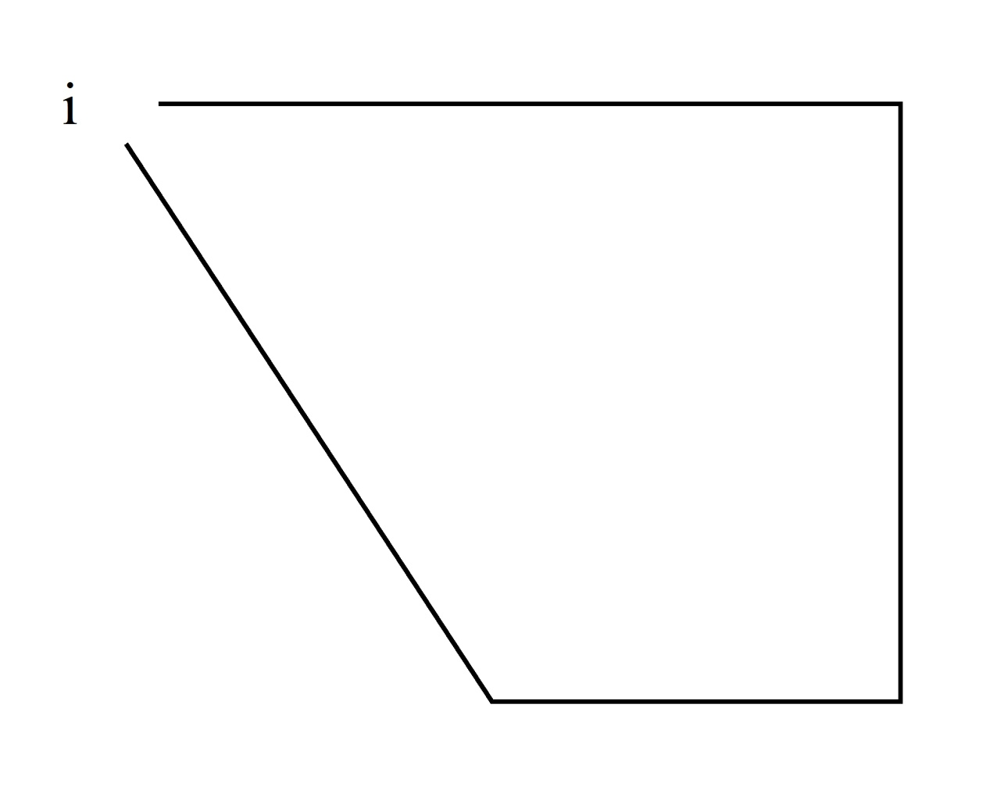
Tongue Position
For example, consider the vowel /i/.

Slide 21
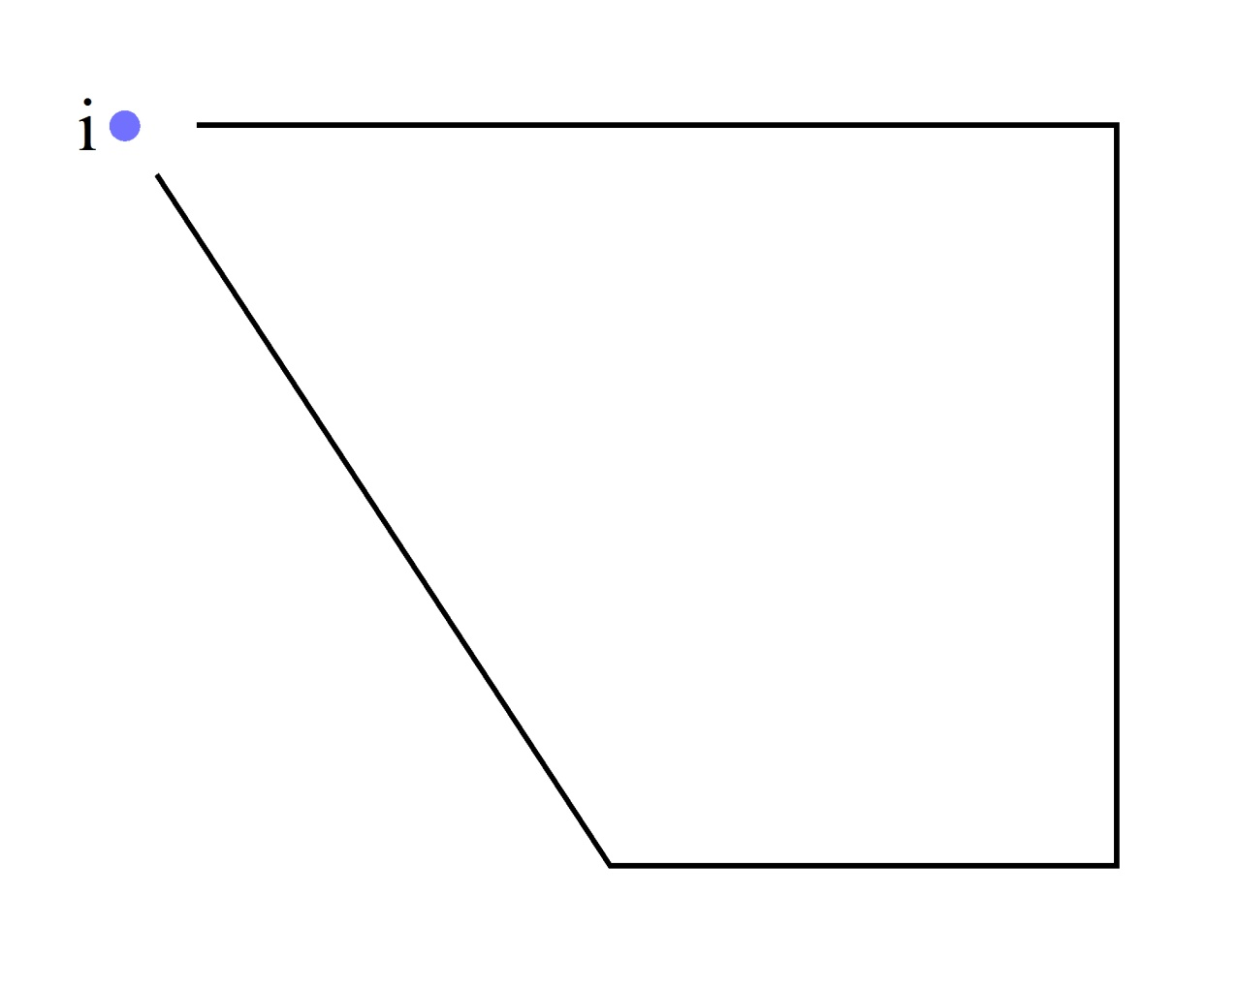
Tongue Position
The highest point is not restricted here.

Slide 22
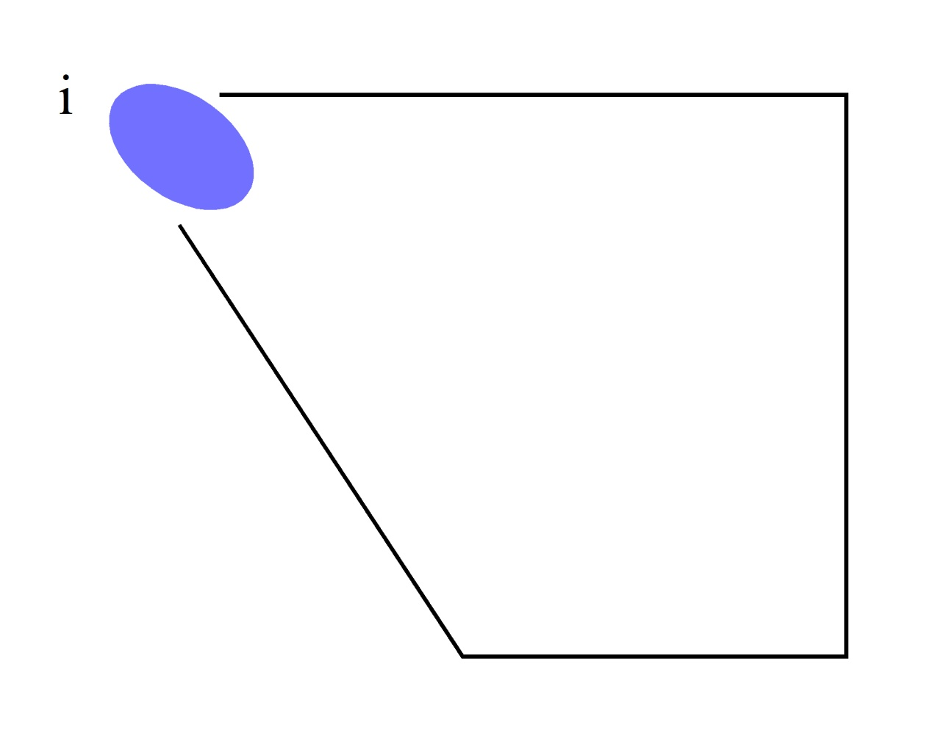
Tongue Position
It can occur anywhere in this range.

Slide 23
Tongue Position
Overall boundaries are also inexact.

Slide 24
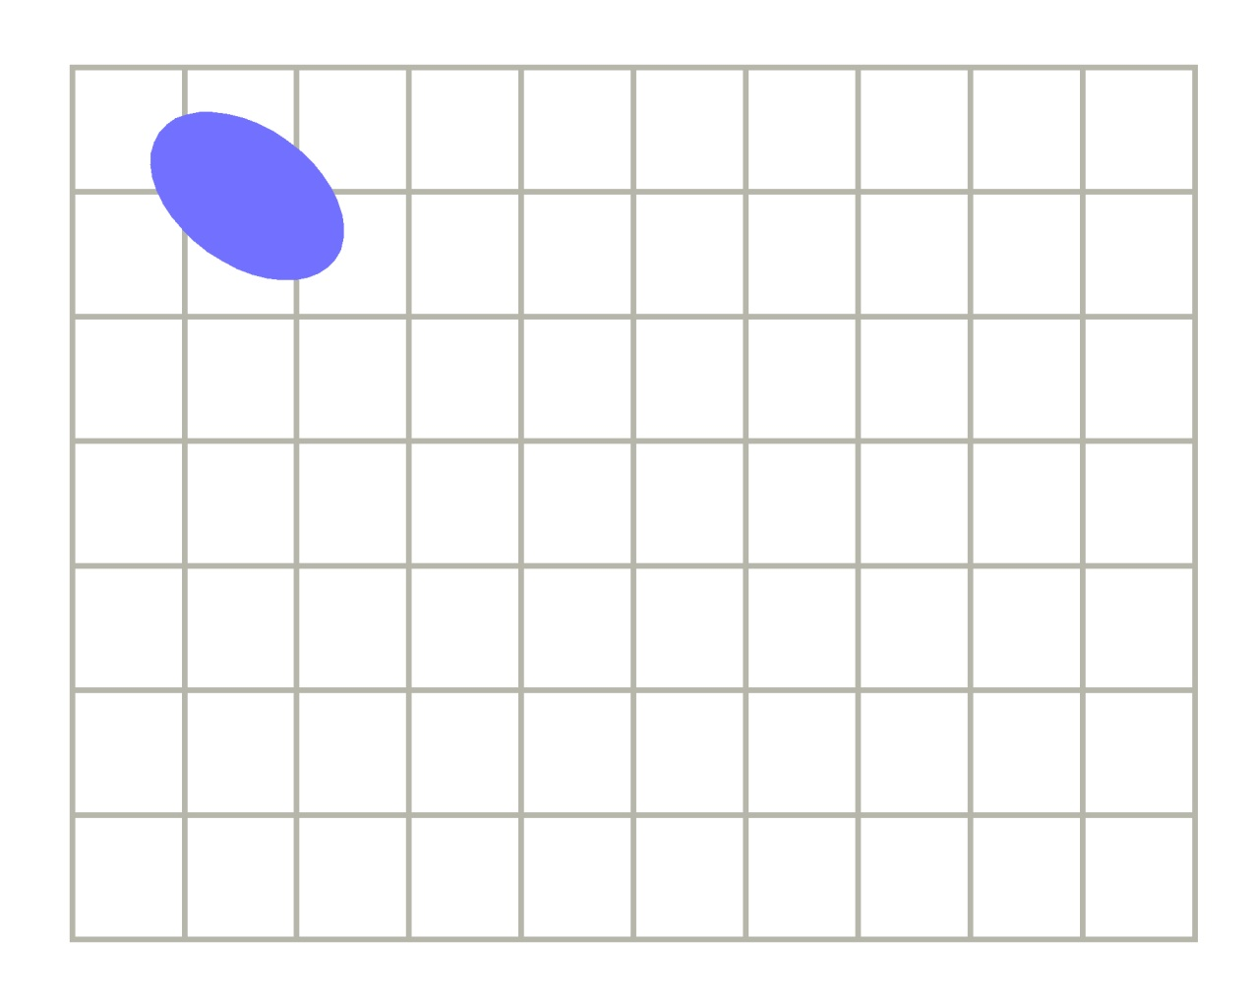
Tongue Position
So, they are replaced by a simple graph.

Slide 25
Tongue Position
This range and graph appear in the feedback.

Slide 26
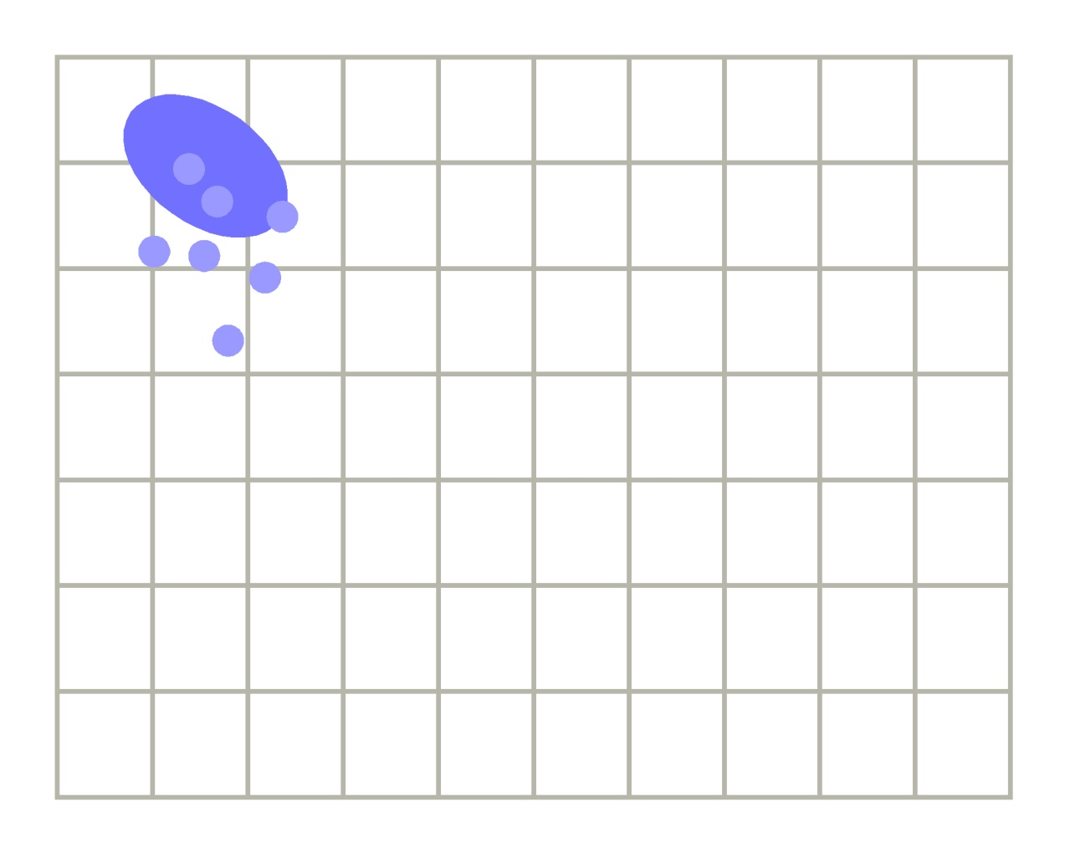
Tongue Position
Your vowels are plotted against them as dots.

Slide 27
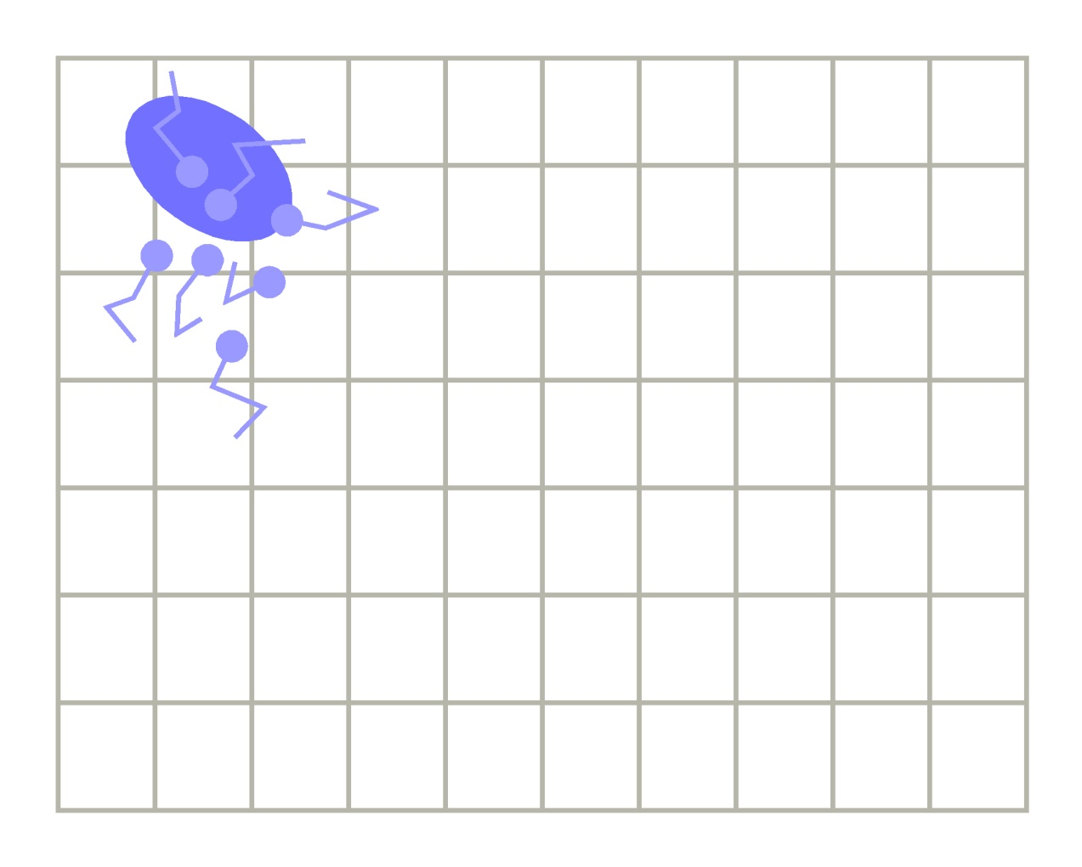
Tongue Position
Small changes in position are shown by tails.

Slide 28
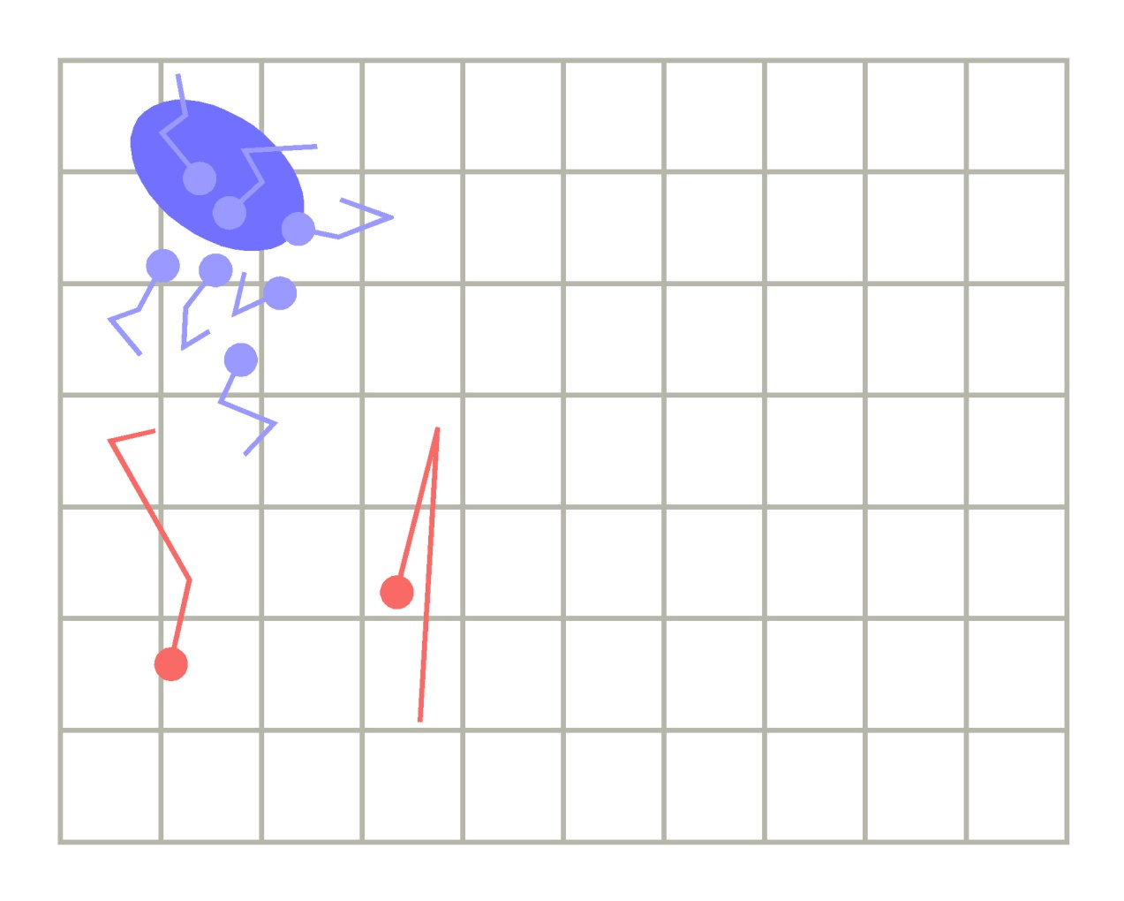
Tongue Position
Likely computer errors are shown in red.

Slide 29
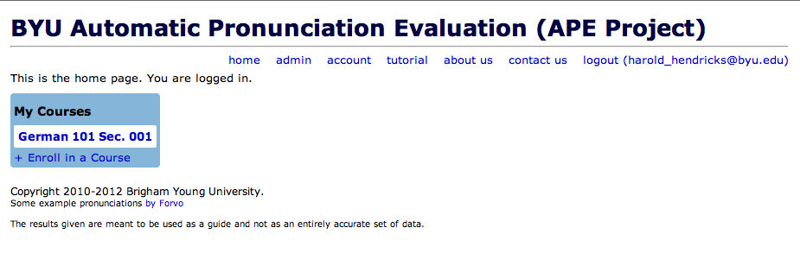
Live demonstration worked!

Slide 30
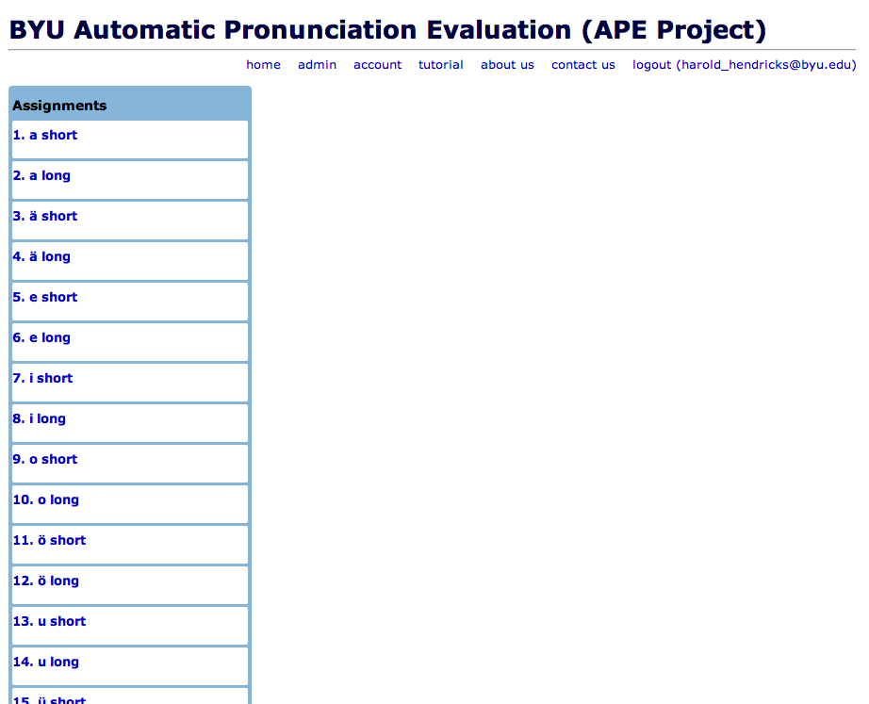

Slide 31
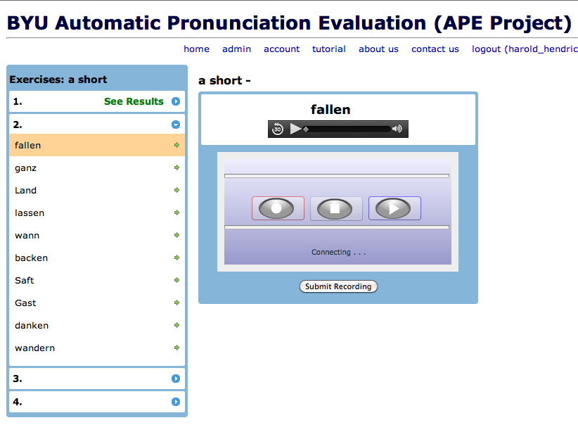

Slide 32
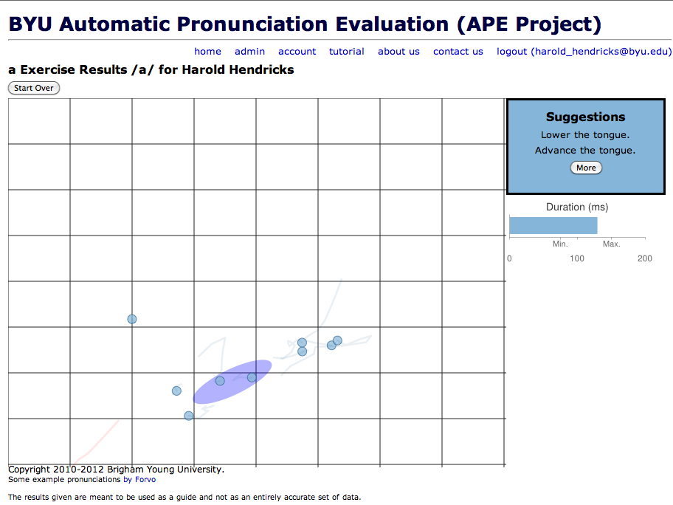

Slide 33
PROGRAM FLOW
SWFObject
Flash Recorder
Flash Media Server
Recording Queue
Praat
Sphinx
sox
FFMPEG
Database
Results to User
Notes:
SPHINX Sphinx looks up the word's pronunciation in the dictionary.
determines the boundaries of each sound
PRAAT scripting language
Reads a file produced by Sphinx
forced alignment
Determines pitch and other formants

Slide 34
Problem
The time between production of vowels in the word list and the view of results causes the student to forget tongue and lip position.
What is needed is a live visualizer.
Maybe something like this…?

Slide 35
Vowel Worm
Demonstration video seen at CALICO 2013
Contacted Harald Frostel, Department of Computational Perception at Johannes Kepler Universität, Linz, Austria.
Project link: http://www.cp.jku.at/projects/realtime/vowelworm.html

Slide 36
Difficulties With Vowel Worm
Written in MATLAB.
Linear Prediction Coefficient seemed to be too slow and we couldn’t get as much raw data as we wanted.
Desired a browser-based solution.

Slide 37
Solutions
MFCC - Mel Frequency Cepstral Coeffients were easier to implement
Converted an MFCC extractor created by David Ireland to javascript.
Browser-based, live-movement, visual feedback.
(Still working on the accuracy.)

Slide 38
References:
Download our work: *http://byu-odh.github.io/apeworm/
MFCC extractor from David Ireland:https://github.com/Maxwell79
Vowel Worm from Harald Frostel: www.cp.jku.at/projects/realtime/vowelworm.html
*Updated from yesterday

